Slide 1
Applied Computer Graphics and Vision
Lecture 05: Triangle Strips and Degenerated Triangles

Slide 2
Overview
Draw triangle strips (gl.TRIANGLE_STRIP)
  The order of the vertex coordinates or indices in the buffers
Degenerated triangles
An example – draw a sphere

Slide 3
A Quick Recap
In last lecture, we have learnt two ways to draw:
  using drawArrays() – drawing from the vertex coordinates directly
  using drawElements() – drawing from vertex indices
In both cases, we considered drawing individual triangles ( as gl.TRIANGLES), therefore the vertex positions or indices that define a triangle are given explicitly – there is no restriction on the order of the positions or indices being stored in the buffer.

Slide 4
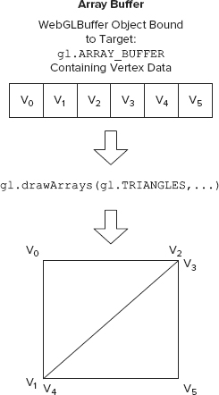
void drawArrays(GLenum mode, GLint first, GLsizei count)

Slide 5
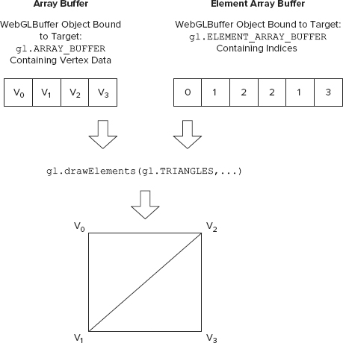
  void drawElements(GLenum mode, GLsizei count, GLenum type, GLintptr offset)

Slide 6
Draw Triangle Strips
We can draw triangle strips by setting the drawing mode flag gl.TRIANGLE_STRIP in
drawArrays() or
drawElements()
functions.
When in gl.TRIANGLE_STRIP mode, the order of the vertex coordinates and indices in the buffers is important.
Instead of specifying triangles by the programmer, WebGL constructs triangles automatically by fetching vertex data from the buffers in a predefined order.

Slide 7
Draw Triangle Strips
Consider the following vertex data in data buffer (vertex coordinate buffer if drawArrays() is used, or index buffer if drawElements() is used),
WebGL pipeline will use them in the following order to construct triangles:
  ABC: first triangle
  CBD: Drop the first item (A), swap the remaining 2 and take a new item (D)
  CDE: Drop the 2nd item (B) and take a new item (E)
  EDF: Drop the 3rd item (C), swap the remaining 2 and take a new item (F)
  EFG: Drop the 4th item (D) and take a new item (G)
  . . .
1 2 3 4 5 6 7 8 …
A
B
C
D
E
F
G
H
…

Slide 8
Vertex Order
For example, in the following strip, if we index the vertices as shown (and store them in the vertex coordinate data buffer in that order) and put 0,1,2,3,4,…10 into the index buffer, then all the triangles will be constructed automatically by calling
  drawElements (gl.TRIANGLE_STRIP, …),
and all triangles have CCW winding.
V₀
V₂
V₄
V₆
V₈
V₁₀
0-1-2
2-3-4
4-5-6
6-7-8
8-9-10
vertex indices of the triangle. Number in blue is newly added vertex for current triangle
2-1-3
4-3-5
6-5-7
8-7-9
V₁
V₃
V₅
V₇
V₉

Slide 9
If we index and store the vertices coordinate in a different order, to draw the strip correctly (using drawElements()) we need to arrange the indices in the index array buffer accordingly:
V₀
V₁
V₂
V₃
V₄
V₅
0-6-1
1-7-2
2-8-3
3-9-4
4-10-5
1-6-7
2-7-8
3-8-9
4-9-10
V₆
V₇
V₈
V₉
V₁₀
The order of index should be: 0,6,1,7,2,8,3,9,4,10,5
V₁
V₃
V₅
V₇
V₉
V₁₀
1-0-3
3-2-5
5-4-7
7-6-9
9-8-10
or
3-0-2
5-2-4
7-4-6
9-6-8
V₀
V₂
V₄
V₆
V₈
The order of index should be: 1,0,3,2,5,4,7,6,9,8,10

Slide 10
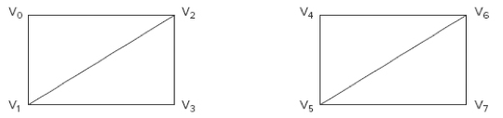
Degenerated Triangles
From the performance point of view, we wish to make as few calls as possible to functions gl.drawArrays() or gl.drawElements().
Suppose we have several independent triangle strips to draw, how can we combine the strips and draw them in one call to the drawing functions?
Independent strip 1
Independent strip 2

Slide 11
Degenerated Triangles
The solution to this discontinuity or jump between strips is to insert extra (duplicated) indices (or vertices if gl.drawArrays()is used).
The inserted extra indices result in degenerated triangles.
A degenerated triangle has at least two indices (or vertices) that are the same, and therefore the triangle has zero area.
Degenerated triangles are easily detected by the GPU and discarded.

Slide 12
Repeat Vertices
The number of extra indices needed for connecting two triangle strips depends on the number of triangles in the first strip.
This is ensure all the triangles of the two strips to have a consistent (same) winding order of the vertices.
We have two cases:
  Case 1: The first strip consists of an even number of triangles. Two extra indices are needed.
  Case 2: The first strip consists of an odd number of triangles. Three extra indices are needed

Slide 13
Case 1
The first strip consists of even number of triangles. For example, 2 triangles:
  The two triangles in 1st strip, (V0, V1, V2) and (V2, V1, V3), correspond to the indices (0, 1, 2, 3) in the element array buffer.
  The second strip also consists of 4 vertices. The two triangles in 2nd strip, (V4, V5, V6) and (V6, V5, V7), correspond to the indices (4, 5, 6, 7) in the element array buffer.
To connect the two strips and to keep the same winding order for both strips, the last vertex of the first strip and the first of the second strip are repeated in the index buffer.

Slide 14
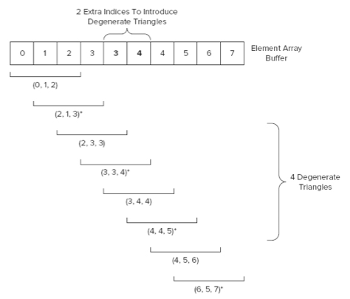
v₀
v₂
v_{3’}
v₄
v₆
v_{3’}=v₃
v_{4’}=v₄
0-1-2
2-3-3’
3’-4’-4
4-5-6
2-1-3
3’-3-4’
4-4’-5
6-5-7
v₁
v₃
v_{4’}
v₅
v₇
＊ indicates reversion of the first two indices

Slide 15
Cont’d
The indices in the element array buffer will be interpreted as a single strip:
  First you have the two triangles of the first triangle strip with index (0, 1, 2) and (2, 1, 3),
  then you have the four degenerate triangles, (2,3,3), (3,3,4), (3,4,4) and (4,4,5) that will be discarded by the GPU, and
  finally you have the two triangles of the last strip with indices (4, 5, 6) and (6, 5, 7).
Question: what if we swap the positions of vertices V_{3’} and V_{4’}?

Slide 16
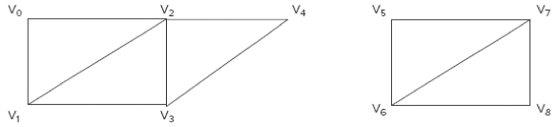
Case 2
The first strip consists of an odd number of triangles,
  The first strip consists of the three triangles (V0, V1, V2), (V2, V1, V3), and (V2, V3, V4). They correspond to the element indices (0, 1, 2, 3, 4) in the element array buffer.
  The second strip consists of triangles (V5, V6, V7) and (V7, V6, V8), corresponds to the element indices (5, 6, 7, 8) in the element array buffer.
In this case, we need to add 3 extra indices to link them as a single strip: repeat the last vertex of the first strip twice and the first vertex in the second strip once.

Slide 17
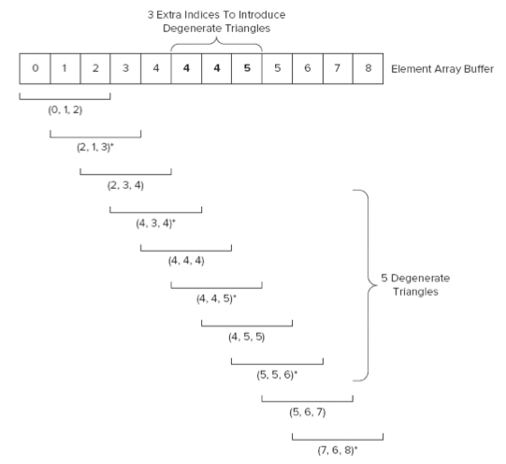
v₀
v₂
v₄
v_{4”}
v₅
v₇
0-1-2
2-3-4
4-4’-4”
4”-5’-5
5-6-7
2-1-3
4-3-4’
4”-4’-5’
5-5’-6
7-6-8
v₁
v₃
v_{4’}
v_{5’}
v₆
v₈
v_{4’}=v_{4’’}=v₄
v_{5’}=v₅

Slide 18
Cont’d
The indices will be interpreted as triangles in a single triangle strip.
  First you have the three triangles of the first triangle strip with index (0, 1, 2), (2, 1, 3), and (2, 3, 4).
  Then you have the five degenerated triangles that will be removed by the GPU.
  Finally, you have the two triangles of the last strip with index (5, 6, 7) and (7, 6, 8).

Slide 19
Use of Triangle Strips
Triangle strip is most efficient/convenient for drawing long ribbon-like shapes.
But it can also be used to draw a mesh like the following:
Here, we can treat the mesh as 4 horizontal (or vertical) strips, and draw the entire mesh in one call. We have to use degenerated triangles at the end of the first 3 strips.
V₀
V₁
V₂
V₃
V₄
V₅
V₆
V₇
V₈
V₉

Slide 20
Acquiring Triangle Mesh
Mesh data generation methods:
  Manual assignment – simple shapes (e.g., shapes used in the tutorials)
  Calculation – for parametric surfaces. Graphics library usually provide calls to draw primitives such as sphere, cylinder, cone, etc.
  Data exported from 3D graphics software.
  Scanning – for complex freeform objects.

Slide 21
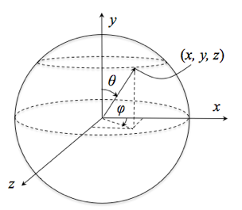
Triangulation of Spheres
To draw a sphere, the sphere needs to be triangulated into triangle mesh consisting of vertex and normal data.
A suitable coordinate system has to be used to facilitate the calculation.
  For spheres – spherical coord. Three parameters: r [0, R], θ [0, π] and φ [0, 2π]
  For cylinders – cylindrical coord. Three parameters: r [0, R], z [0, H] and φ [0, 2π]

Slide 22
Sphere in Spherical Coord.
In spherical coordinate system, a sphere take the form:
    x = r sinθ cosφ
    y = r cosθ
    z = r sinθ sinφ
where r is the radius of the sphere, and with θ: [0, π] and φ: [0, 2π]
The coordinates of each and every points on the sphere can be calculated by this set of equations.

Slide 23
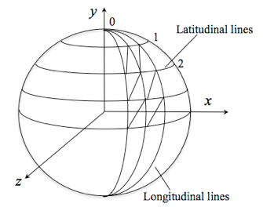
Sphere Triangulation
To triangulate the the sphere, we divide the surface into m horizontal (latitudinal) strips and n vertical (longitudinal) strips, which means it has m+1 rows and n+1 columns (the last column repeats the first column) of vertices.
m horizontal strips
n vertical strips

Slide 24
Cont’d
By this division, we can compute the values of θ and φ for a vertex at ith row and jth column, v_{i,j}
  θ_{i,j}=iπ/m (i=0,1,…, m)
  ϕ_{i,j}=2jπ/n (j=0,1,…, n)
v_{1,2}
v_{1,1}

Slide 25
Calculate Coordinates
Then coordinates of the vertex v_{i,j} can be calculated by substituting θ with iπ/m and ϕ with 2jπ/n:
  x = r sinθ cosφ= r sin(iπ/m) cos(2jπ/n)
  y = r cosθ = r cos(iπ/m)
  z = r sinθ sinφ = r sin(iπ/m) sin(2jπ/n)
This calculation has to be done for every vertex

Slide 26
Generate Vertex Data Arrays
Suppose we use drawElements() and gl.TRIANGLES to draw the sphere.
Of course you can use gl.TRIANGLE_STIRP, but you will need to
  add the extra indices to create the degenerated triangles that link the strips as one.
  arrange the indices in the correct order in the array
Use gl.TRIANGLES simplifies the the index generation process, even though it require a larger buffer space to store the vertex indices. For a simple object like sphere, this is not a big deal.

Slide 27
Vertex Coordinates
We use two loops to calculate the vertex positions. Suppose we store the vertices in a JavaScript array:
    var vertexPosition = [];
    for (var i=0; i <= m; i++) {
    for (var j=0; j <= n; j++) {
    //Calculate x,y,z
    vertexPosition.push(x);
    vertexPosition.push(y);
    vertexPosition.push(z);
    }
    }
This procedure stores the vertex coordinates in such an order:
  1st row of vertices (i=0 and j=0,1,2,…n), then
  2nd row of vertices (i=1 and j=0,1,2,…n),
  …

Slide 28
Vertex Indices
Consider a vertex at ith row and jth column: 4 vertices v_{i,j}, v_{i,j+1}, v_{i+1,j} and v_{i+1,j+1} define two triangles:
  (v_{i,j}, v_{i+1,j}, v_{i,j+1}) and
  (v_{i+1,j}, v_{i+1,j+1}, v_{i,j+1}).

Slide 29
Cont’d
According to the order of the vertex coordinates being stored, we can work out the indices of these vertices:
  index of v_{i,j} = i*(n+1)+j
  index of v_{i,j+1} = index of v_{i,j} + 1
  index of v_{i+1,j} = index of v_{i,j} + n + 1
  index of v_{i+1,j+1} = index of v_{i+1,j} +1
1
3
2
4

Slide 30
Cont’d
var indexData = [];
for (var i=0; i < m; i++) {
for (var j=0; j < n; j++) {
var v1 = i*(n+1) + j;//index of v_{i,j}
var v2 = v1 + n + 1; //index of v_{i+1,j}
var v3 = v1 + 1; //index of v_{i,j+1}
var v4 = v2 + 1; //index of v_{i+1,j+1}
// indices of first triangle
indexData.push(v1);
indexData.push(v2);
indexData.push(v3);
// indices of second triangle
indexData.push(v3);
indexData.push(v2);
indexData.push(v4);
}
}

Slide 31
Vertex Normals
The vertex normal of a vertex, n, is simply
  n_{x} = sinθ cosφ= sin(iπ/m) cos(2jπ/n)
  n_{y} = cosθ = cos(iπ/m)
  n_{z} = sinθ sinφ = sin(iπ/m) sin(2jπ/n)
Notice that we have omitted the radius r from the formula of spheres, because we are working with unit vectors (length=1).

Slide 32
Cont’d
var normalData = [];
  for (var i=0; i <= m; i++) {
  for (var j=0; j <= n; j++) {
  //Calculate nx,ny,nz
  normalData.push(nx);
  normalData.push(ny);
  normalData.push(nz);
  }
  }

Slide 33
Further Reading
Anyuru, A., WebGL Programming – Develop 3D Graphics for the Web
  Chapter 3

